Slide 1

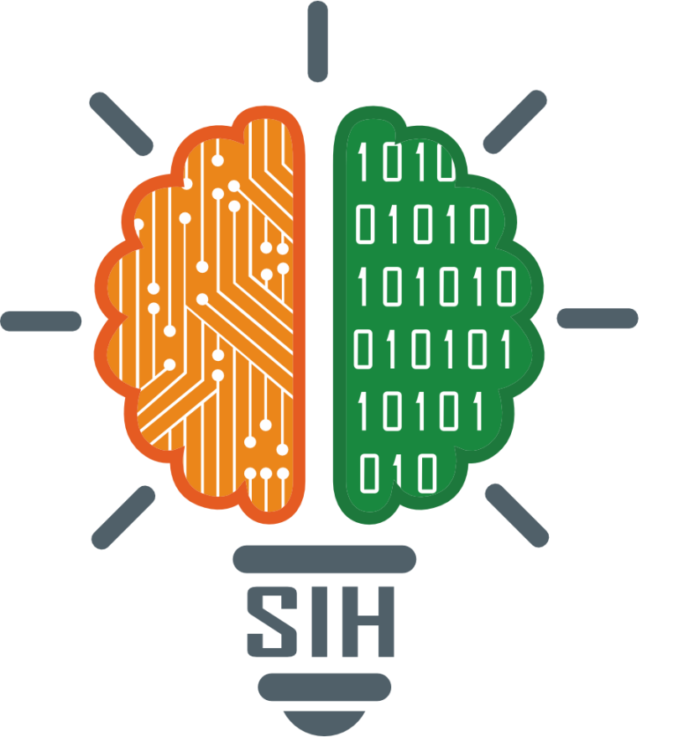
SMART INDIA HACKATHON 2025
TITLE PAGE
Problem Statement ID –SIH25063
Problem Statement Title- Real-time neutral conducter breakage detection in low voltage distribution networks
Theme- Disaster management
PS Category- Hardware
Team ID-
Team Name – TEAM KANYARAASHI

Slide 2

Real-time neutral conducter breakage detection
KANYARAASHI
IDEA / SOLUTION :
Introduction In low-voltage power distribution, the neutral conductor plays a very important role in keeping voltages balanced. If the neutral wire breaks, it can cause serious problems like unbalanced voltages, damage to electrical equipment, fire hazards, and even safety risks.
Continuous monitoring of phase-to-neutral voltages..
Real-time detection of abnormal unbalance.
Automatic alerts to users.
Relay-based automatic disconnection to prevent damage.
Can integrate with IoT for remote monitoring and safety enhancement
Problem Resolution :
Measure the voltages of each phase with respect to neutral in real-time.
Compare the measured values with balanced conditions.
If any abnormal unbalance is found → it means the neutral is broken.
System will take action:Send an alert to the user.Or disconnect supply using a relay to protect appliances
Unique Value Propositions (UVP) :
Real time safety – Detects neutral conductors breackage instantly before damage happens
Low cost solution – Uses simple sensors and microcontroller ,making affadable and scalable.
Automatic protection – Not only alerts and it can disconnects the supply automatically.

Slide 3

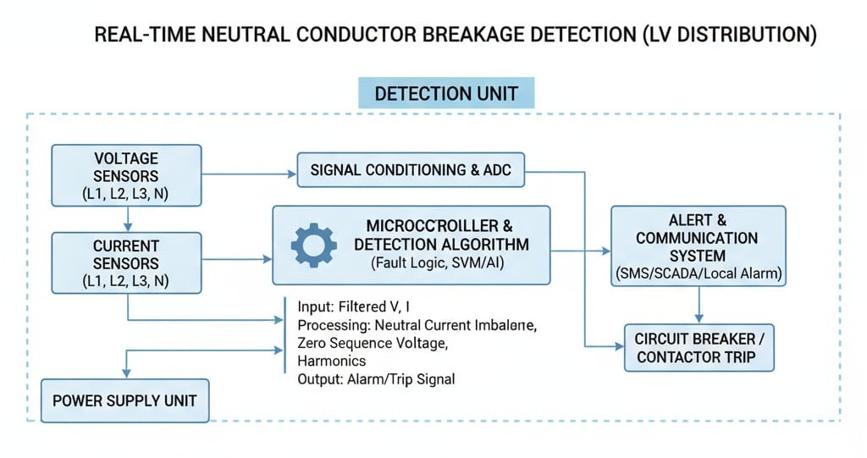
BLOCK DIAGRAM
KANYARAASHI
Scripting Languages: Arduino C++/Embedded – For programming microcontroller(ESP32/Arduino)
Database:
SQLite - local storage of voltage/current reading and logs devices.
MongoDB- Centralized storage for cloud. integration,large-scale IOT data,and alerts.
Security:
AES : To product sensitive sensor data and event logs before storage/transmission.
HTTPS protocal: For secure data transmission from devices to cloud/dashboard.
Model:
Rule-based detection (current code):threshould-based
imbalance check for neutral break.

Slide 4
FEASIBILITY AND CHALLENGES
KANYARAASHI
FEASIBILITY
Technical feasibility
Software tools like arduino IDE , MATLAB are widely available and easy to use.
IOT , threshold-based detection logic are proven and reliable
Economy feasibility
Hardware cost is low.
Scalable solution-same can be used for homes and industries.
Operational feasibility
Easy to install in existing distribution systems.
Automatic alerts and protection make it user-friendly
Scalability feasibility
Can start as a standalone system for households.
Supports future upgrades like predictive algorithams.
CHALLENGES
Accurate detection
Differentiating Between normal voltage fluctuation and actual neutral breakage.
Hardware reliability
Voltage sensors must be calibrated correctly
Real time processing
Ensuring microcontroller processes data fast enough to trigger immediate protection.
Integration with IOT
Stable internet connectivity require for remote monitoring.
Power supply issuses
System itself should remain powered during faults or volage fluctuations.

Slide 5
IMPACT AND BENEFITS
KANYARAASHI
Impact | Benefits
Enhanced safety | Real time Detection
Prevents fire hazards and electrical accidents by detecting neutral breakage in real time. | -neutral failures identified instantly.
Protection and appliances | Automatic Protection
-saves households and industrial equipment from voltage imbalance damage. | -relay disconnection prevents costly damage.
User Awarence | Esay installation
-provides alerts that help user act quickly and avoid risks. | -can be added to existing systems without major changes .

Slide 6
RESEARCH AND REFERENCES
KANYARAASHI
RESEARCH
1. Background Research
In low-voltage distribution networks, neutral wire failure leads to unbalanced voltages, which cause equipment damage, fire hazards, and safety risks.
Current protective devices (MCBs, RCCBs, Fuses) do not detect neutral breakage in real time.
2. Existing Studies / Benchmarks
IEEE Standards highlight the need for improved protection in low-voltage systems.
Indian Standard IS 732 & IS 3043 focus on safety in earthing and wiring but lack real-time monitoring for neutral failures.
3. Market Research
Growing demand for smart meters, IoT devices, and power quality monitoring in India’s smart grid mission.
The Smart Grid market is projected to cross USD 140 Billion by 2030 (MarketsandMarkets).
REFERENCE
Research Papers / Technical Studies
A. Majumder, “Detection and Mitigation of Neutral Conductor Failures in Low-Voltage Networks,” IEEE Transactions on Power Delivery, 2019.
R. Gupta & S. Kumar, “IoT Based Monitoring of Distribution Systems for Smart Grids,” International Journal of Electrical Power & Energy Systems, 2021.
Arduino IDE and MicroPython Documentation.
MATLAB/Simulink Official Documentation.
MongoDB Official Documentation.
5. Web Resources
Government of India, Ministry of Power – National Smart Grid Mission.
IEEE Xplore Digital Library – https://ieeexplore.ieee.org.

